Slide 1
ACM Website
By Matthew Woodhead

Slide 2
Purpose
Intended for the ACM RSO
Made for programmers
Simple and usable

Slide 3
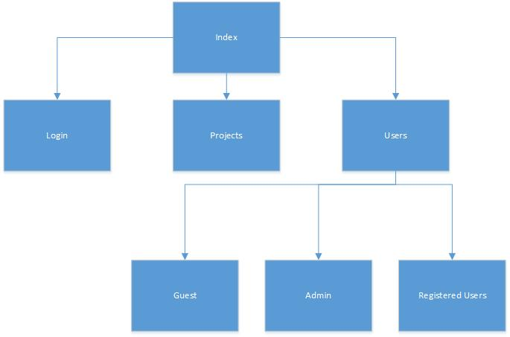
Site Map

Slide 4
Link
ACM\index.html

